Slide 1


Optimal Resource Allocation in MU-MIMO Systems with Soft Video Delivery
Ticao Zhang and Shiwen Mao
School of Electrical and Computer Engineering
Auburn University
Auburn, AL 36849-5201
A proposal to the FiWIN IAB

Slide 2
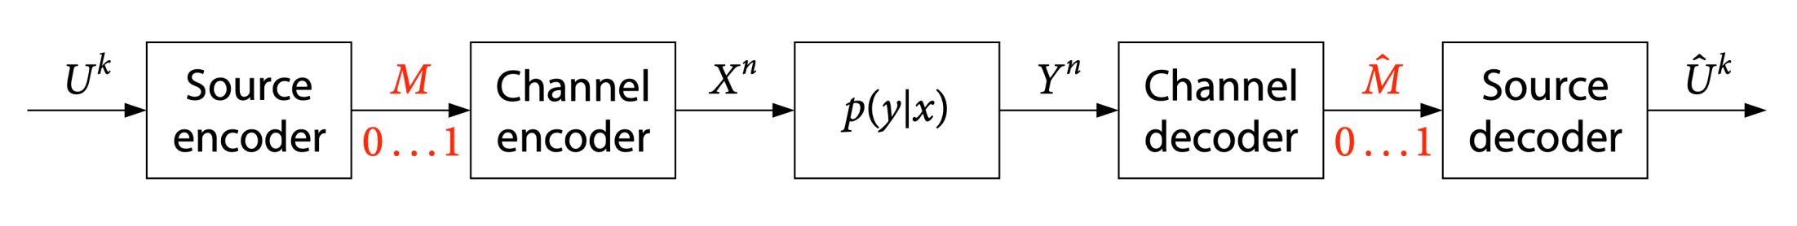
Problems to Solve and Industrial Relevance
Demand for wireless video
78% of the world’s mobile data traffic will be video related by 2021
Video call, IPTV, video conference, video live streaming are boosting
Efficient and robust wireless video transmission technology
Conventional video coding (MPEG-4 over 802.11)
Shannon’s source-channel separation theorem
Source coding: represent video with the minimum number of bits (prediction, transformation, quantization and entropy coding)
Channel coding: correct errors (reliable transmission)
Drawback
Lack of flexibility in handling channel and user heterogeneity
Suffers from cliff-effect
Reasons
The sensitivity of entropy coding to bit errors
In low SNR regime, error correction coding breakdown
Quantization distortion cannot be recovered
The bitrate for video broadcast/multicast cannot fit all receivers at the same time
Cisco visual networking index: Global mobile data trafﬁc forecast update, 2016–2021 white paper.

Slide 3
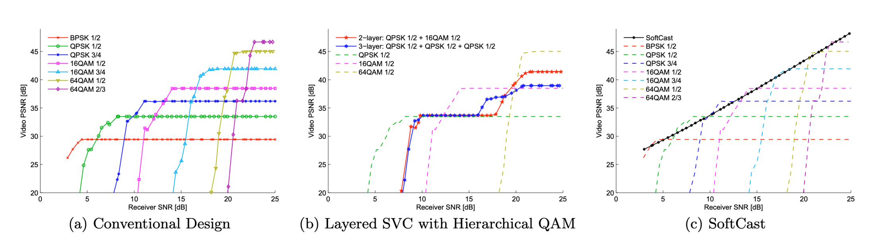
Problems to Solve and Industrial Relevance
Layered scalable video coding (SVC)
Separate channel and source coding + local buffer
Encoder adjusts the source coding rate according to the buffer size
Transmitter chooses the most appropriate modulation rate to send the packet out
Drawback
The efficiency of adaptive modulation and coding (AMC) relies on the timeliness and precision of channel feedback
A difficult engineering tradeoff between the channel adaptation capability and the amount of induced delay
Still suffers from the cliff-effect
Soft video transmission (SoftCast)
Conventional design suffers severe cliff effect
Layered video makes the cliff milder but introduced overhead and reduces the maximum video quality
SoftCast video quality scales with the channel quality
cliff effect
Jakubczak, S., & Katabi, D. (2011). Softcast: one-size-fits-all wireless video. ACM SIGCOMM Computer Communication Review, 41(4), 449-450.

Slide 4
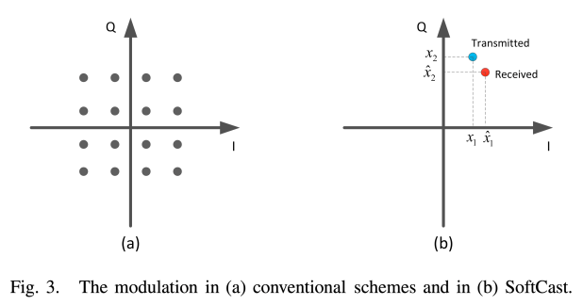
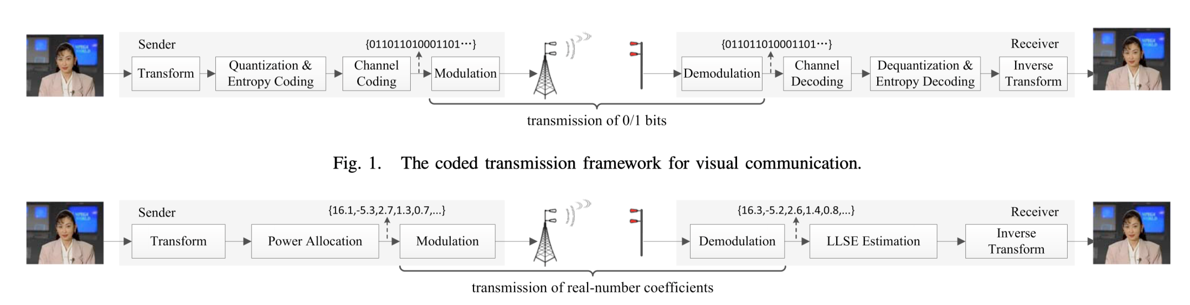
Problems to Solve and Industrial Relevance
Modulation comparison
Soft video transmission (SoftCast)
Features
Joint channel and source coding
Skips quantization and entropy coding
Transmit power scaled discrete cosine transform (DCT) coefficients
Amplitude modulation to minimize the end-to-end distortion
All operations involved are linear
Users gracefully improve video quality matching to their wireless channel quality
Comparison
Modulation
Framework
Conventional video transmission
SoftCast
Conventional video transmission
SoftCast
R. Xiong, J. Zhang, F. Wu, J. Xu, and W. Gao, “Power distortion optimization for uncoded linear transformed transmission of images and videos,” IEEE Trans. Image Process., vol. 26, no. 1, pp. 222–236, Jan. 2017.

Slide 5
Problems to Solve and Industrial Relevance
Soft video transmission (SoftCast)
System Model
Linear decoder
Optimal power allocation
Solution
Challenges
signal energy distribution (SED) needs to be well handled and exploited by the sender and receiver
The overhead of metadata should be reduced
A cross-layer joint resource optimization
Incorporate the current soft video delivery system to a MU-MIMO system
Hybrid digital and analog modulation
…
is the power of each transmitted coefficient

Slide 6
Existing Solutions and Their Limitations
Accurate signal energy distribution modeling
Limitation
Softcast: performance depends on chunk size, large metadata overhead
L-shape modeling: simple but there is still large metadata overhead
Gaussian Markov Random Field (GMRF) modeling: complex and not accurate enough
DCT
DCT coefficients into chunks
(a) the original video sequence (b) the corresponding DCT coefficients (c) the corresponding power (d) the corresponding power scaling coefficients
(a) Signal empirical distributions (SED)
for picture Lena, gray (b) SoftCast (c) L-shape modeling (d) GMRF modeling
[1] T. Fujihashi, T. Koike-Akino, T. Watanabe, and P. V. Orlik, “High-quality soft video delivery with GMRF-based overhead reduction,” IEEE Trans. Multimedia, vol. 20, no. 2, pp. 473–483, Feb. 2018.
[2] R. Xiong, J. Zhang, F. Wu, J. Xu, and W. Gao, “Power distortion optimization for uncoded linear transformed transmission of images and videos,” IEEE Trans. Image Process., vol. 26, no. 1, pp. 222–236, Jan. 2017.
(a) the original video sequence (b) the corresponding DCT coefficients (c) the corresponding power (d) the corresponding power scaling coefficients

Slide 7
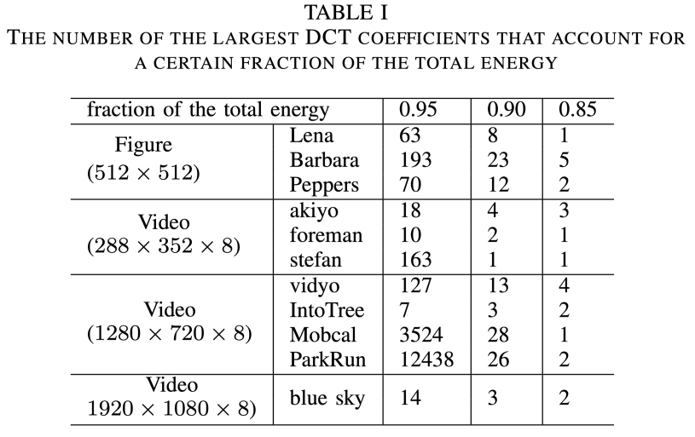
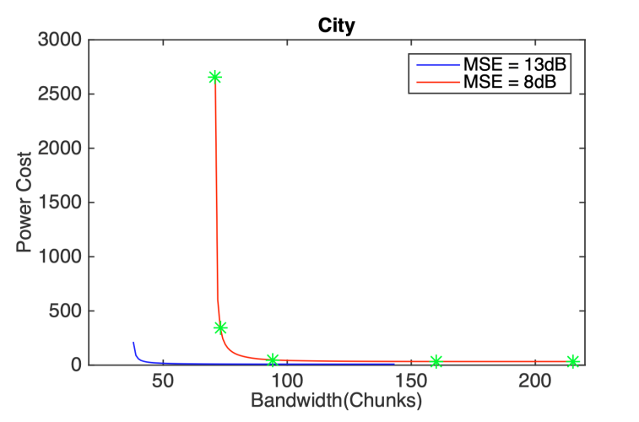
Existing Solutions and Their Limitations
Joint power and bandwidth allocation
A large redundancy in the DCT coefficient
Power and bandwidth tradeoff
Cost-distortion optimization solution (heuristic)
Resource allocation algorithm design
Limitation
Only works in single-input single-output (SISO) channel
A cross-layer joint optimization is needed
Redundancy in DCT coefficients
Power and bandwidth tradeoff
D. Liu, J. Wu, H. Cui, D. Zhang, C. Luo, and F. Wu, “Cost-distortion optimization and resource control in pseudo-analog visual communications,” IEEE Trans. Multimedia, 2018.
(a) the original video sequence (b) the corresponding DCT coefficients (c) the corresponding power (d) the corresponding power scaling coefficients

Slide 8
Proposed Solution and Its Benefits
Proposed solution
Blind signal detection
Scales each coefficient with an optimal scaling factor at the encoder
Recover the video signal from the amplitude of the square of the received signal at the decoder
Theoretical PSNR performance
is the signal-to-noise ratio
A cross layer joint bandwidth and power allocation
Theoretical PSNR performance
Geometric programming
Benefits
Metadata-free
Theoretical results provide accurate prediction
Improved PSNR performance
Better optimization algorithm
is the signal to noise ratio

Slide 9
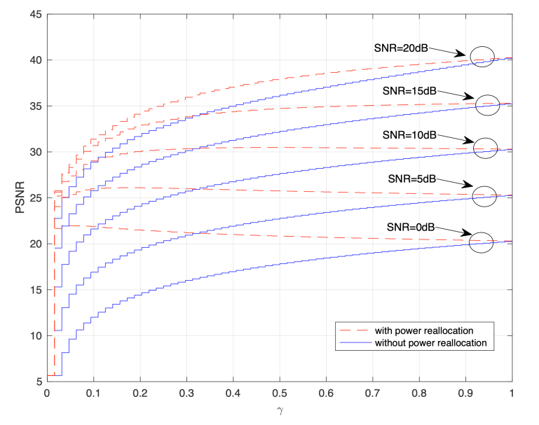
Preliminary results
Simulation results
Proposed blind detection method
Power and bandwidth tradeoff
Outperforms SoftCast by approximately 2dB
Metadata-free
No SED modeling process
A trade-off between power allocation and bandwidth usage

Slide 10
Challenges and Risks
Problems | Solutions
An extension to MIMO-OFDM | SVD channel decomposition Parallel SISO channels
Joint MU-MIMO resource allocation | Geometric optimization The derived theoretical results provide accurate prediction Low cost and efficient algorithms
Accurate SED modeling | Fit the SED plane with Gaussian process Fit the SED plane with deep learning
Testbed implementation | USRP Low complexity implementation 360º/HD video transmission Virtual reality extension

Slide 11
Outcomes for Project Evaluations
Expected Benefits | Current Solution | Our Proposed Solutions
Improved PSNR performance | Chunk division | Blind detection that skips chunk division
Reduced bandwidth usage | Discard the least important chunks | Power reallocation with the aid of the derived theoretical results
Joint bandwidth and power optimization | A heuristic optimization/SISO channel | SVD channel decomposition + A cross layer joint optimization
An extension to MU-MIMO | Not supported

Slide 12
Schedule and Tasks
Tasks | Schedule
 | H1 | H2 | H3 | H4
Investigation of an accurate signal detection algorithm with reduced metadata
Investigation of the theoretical performance for power-distortion optimization
Investigation of power and bandwidth usage tradeoff in a SISO soft video delivery system
Investigation of joint power and bandwidth allocation in an MU-MIMO soft video delivery system
Budget: (1 year) $25,000
Manpower: 1 GRA

Slide 13
Thank You! Email: smao@ieee.org

